Slide 1





The 36 Rules of Legal Writing
The most important rules for lawyers to know to avoid their most common mistakes in legal writing
John James McVeigh DTEFL, MBA, LLM
 | John James McVeigh DTEFL, MBA, LLM Chief Executive Officer, Nixedonia +44-7534-729-009 (Mobile & WhatsApp) james@36rules.com http://www.36rules.com/

Slide 2





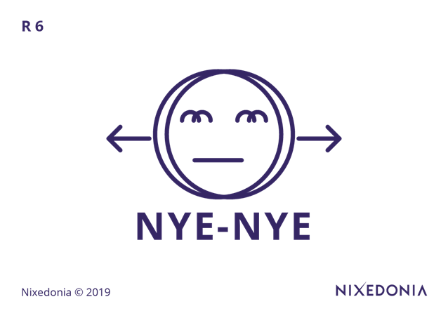

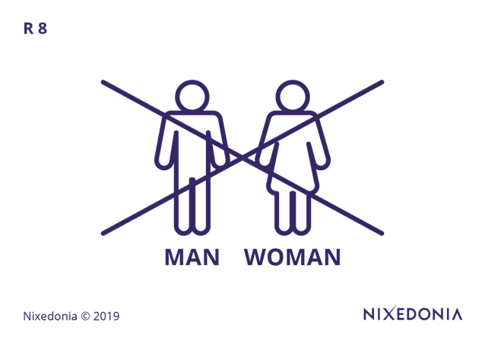

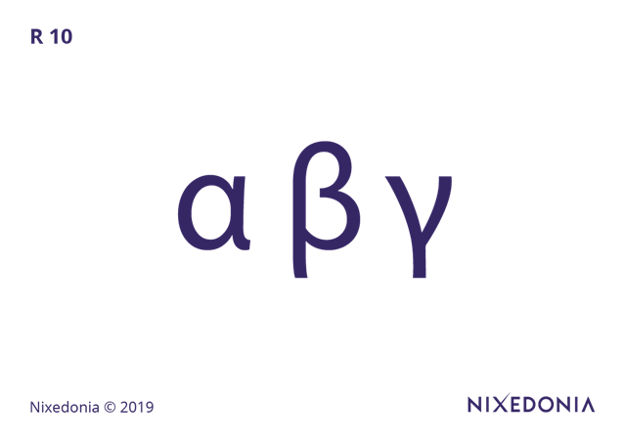














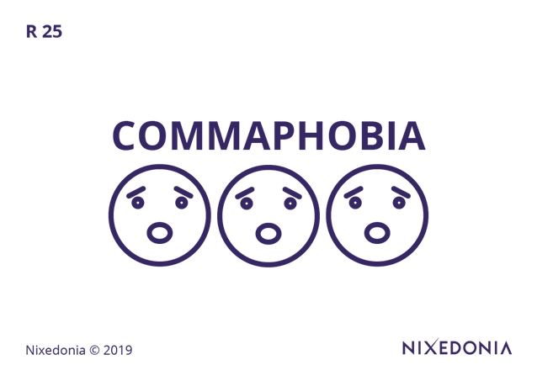











The 36 Rules
of Legal Writing & Their Pictograms

Slide 3
The 36 Rules of Legal Writing – Rule 01/36
1. The Plain English Rule
Nixedonia © 2023

Slide 4
The 36 Rules of Legal Writing – Rule 01/36
Legal writing must prioritize clarity and accessibility, avoiding archaic language and unnecessary legal jargon that can obscure meaning. Terms like “heretofore” or “aforementioned” may appear formal, but they often hinder comprehension and should be replaced with straightforward phrasing. The goal is to ensure that the intended audience—whether a judge, client, or opposing counsel—can easily grasp the message without unnecessary complexity.
1. The Plain English Rule
Nixedonia © 2023

Slide 5
The 36 Rules of Legal Writing – Rule 01/36
Mistake:
Pursuant to the foregoing contractual provisions and in accordance with the principles articulated therein, it is deemed appropriate to proceed with the execution of the obligations set forth.
Correction:
Under the contract’s terms, it is appropriate to proceed with performance.
1. The Plain English Rule
Nixedonia © 2023

Slide 6
The 36 Rules of Legal Writing Exercises
The contractual obligation, as articulated in the governing agreement, necessitates a comprehensive assessment of the prevailing circumstances prior to the initiation of any remedial action.
Contact me – John James McVeigh – for the free model answer:
james@36rules.com
EXERCISES
Nixedonia © 2023

Slide 7

The 36 Rules of Legal Writing – Rule 02/36
2. The 1-Ruble Rule
Nixedonia © 2023

Slide 8
The 36 Rules of Legal Writing – Rule 02/36
Every word in legal writing should justify its presence; if it does not add value, it should be removed. Excessive verbosity, sometimes mistaken for thoroughness, dilutes clarity and increases the cognitive burden on the reader. A concise legal document communicates its points efficiently, reducing the risk of misinterpretation and enhancing persuasive power.
2. The 1-Ruble Rule

Slide 9
The 36 Rules of Legal Writing – Rule 02/36
Mistake:
It is the considered opinion of the undersigned legal counsel that, in light of the evidentiary materials submitted herewith, the defendant has failed to meet the requisite burden of proof necessary to establish a prima facie case.
Correction:
The defendant has not met the burden of proof to establish a prima facie case.
2. The 1-Ruble Rule

Slide 10
The 36 Rules of Legal Writing Exercises
Owing to the fact that the appellate brief was replete with superfluous verbiage, the reviewing panel expended an inordinate amount of time parsing its substantive content.
Contact me – John James McVeigh – for the free model answer:
james@36rules.com
Nixedonia © 2023

Slide 11

The 36 Rules of Legal Writing – Rule 03/36
3. The SVO Rule
Nixedonia © 2023

Slide 12
The 36 Rules of Legal Writing – Rule 03/36
The natural word order in English follows a Subject-Verb-Object (SVO) structure, which enhances clarity and readability. Sentences that deviate from this order—particularly through unnecessary passive constructions or embedded clauses—can obscure meaning and create ambiguity. Ensuring that subjects act upon objects in a direct manner reduces complexity and makes legal arguments more compelling.
3. The SVO Rule

Slide 13
The 36 Rules of Legal Writing – Rule 03/36
Mistake:
A decision on the motion for summary judgment, after careful consideration of the affidavits submitted and in light of the controlling precedent, was issued by the court.
Correction:
The court issued a decision on the motion for summary judgment after considering the affidavits and precedent.
3. The SVO Rule

Slide 14
The 36 Rules of Legal Writing Exercises
The motion, after extensive consideration by the presiding judge and in consultation with the involved parties, was ultimately denied.
Contact me – John James McVeigh – for the free model answer:
james@36rules.com
Nixedonia © 2023

Slide 15

The 36 Rules of Legal Writing – Rule 04/36
4. The Shan’t Rule
Nixedonia © 2023

Slide 16
The 36 Rules of Legal Writing – Rule 04/36
The word “shall” has been widely misused in legal documents, creating ambiguity rather than certainty. Because “shall” can imply obligation, futurity, or mere possibility depending on context, modern drafting practices recommend clearer alternatives such as “must” (for obligations) or “will” (for future actions). Eliminating “shall” from contracts and statutes minimizes interpretative disputes and aligns with modern drafting conventions.
4. The Shan’t Rule

Slide 17
The 36 Rules of Legal Writing – Rule 04/36
Mistake:
The purchaser shall, upon receipt of written notice of delivery, remit full payment to the seller in accordance with the terms stipulated herein.
Correction:
The purchaser must pay in full upon receiving written notice of delivery.
4. The Shan’t Rule

Slide 18
The 36 Rules of Legal Writing Exercises
The lessee shall effectuate monthly rental payments to the lessor in strict accordance with the financial stipulations enshrined within the contractual framework.
Contact me – John James McVeigh – for the free model answer:
james@36rules.com
Nixedonia © 2023

Slide 19

The 36 Rules of Legal Writing – Rule 05/36
5. The Babushka Rule
Nixedonia © 2023

Slide 20
The 36 Rules of Legal Writing – Rule 05/36
If a non-specialist, such as an elderly layperson with no legal training, cannot understand a legal document, it is likely too convoluted. While legal writing must maintain precision, it should also strive for clarity by explaining legal concepts in a way that avoids excessive complexity. Writing in a way that allows an intelligent, non-legal reader to follow the argument ensures accessibility and reduces the likelihood of disputes arising from misinterpretation.
5. The Babushka Rule

Slide 21
The 36 Rules of Legal Writing – Rule 05/36
Mistake:
The doctrine of equitable estoppel precludes the plaintiff from asserting a position inconsistent with prior representations, upon which the defendant detrimentally relied.
Correction:
The plaintiff cannot take a position that contradicts past statements if the defendant relied on them to their detriment.
5. The Babushka Rule

Slide 22
The 36 Rules of Legal Writing Exercises
Pursuant to the statutory provisions in force, the obligor shall fulfill the debt repayment obligation within a period not to exceed ninety (90) calendar days.
Contact me – John James McVeigh – for the free model answer:
james@36rules.com
Nixedonia © 2023

Slide 23
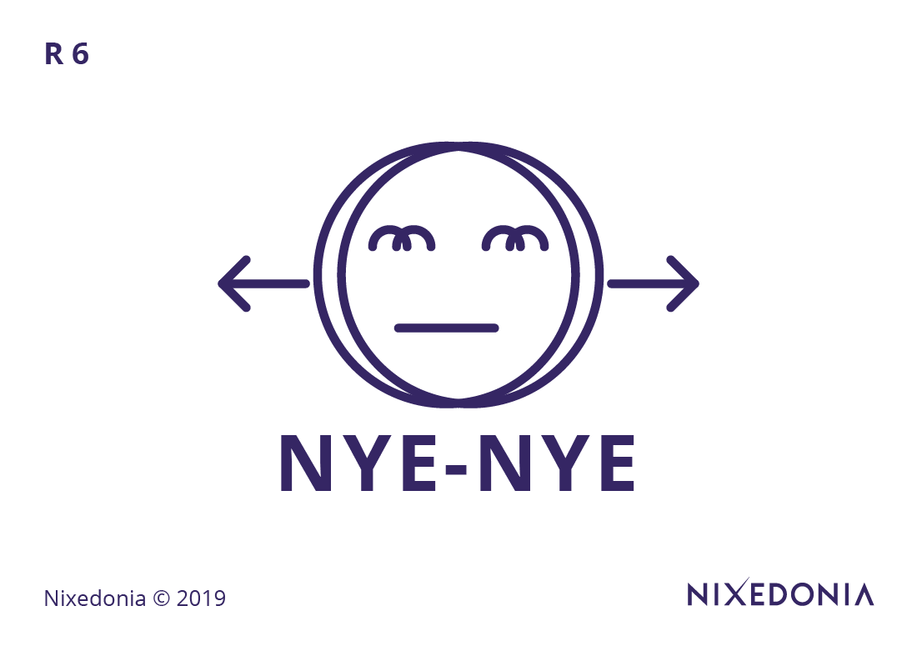
The 36 Rules of Legal Writing – Rule 06/36
6. The Nye-Nye Rule
Nixedonia © 2023

Slide 24
The 36 Rules of Legal Writing – Rule 06/36
Double negatives and convoluted negations create unnecessary confusion and should be avoided in legal writing. A phrase such as “the plaintiff is not precluded from filing” is weaker than simply stating, “the plaintiff may file.” Expressing ideas in a positive, direct manner enhances clarity and ensures that legal obligations and rights are immediately comprehensible.
6. The Nye-Nye Rule

Slide 25
The 36 Rules of Legal Writing – Rule 06/36
Mistake:
It is not the case that the claimant has failed to provide sufficient evidence to refute the allegations set forth by the respondent.
Correction:
The claimant has provided enough evidence to refute the respondent’s allegations.
6. The Nye-Nye Rule

Slide 26
The 36 Rules of Legal Writing Exercises
It is not without some measure of uncertainty that the claim might not be entirely devoid of legal merit.
Contact me – John James McVeigh – for the free model answer:
james@36rules.com
Nixedonia © 2023

Slide 27

The 36 Rules of Legal Writing – Rule 07/36
7. The KISS Rule
Nixedonia © 2023

Slide 28
The 36 Rules of Legal Writing – Rule 07/36
The Keep It Simple, Silly (KISS) principle underscores the importance of brevity and clarity in legal writing. Overly complex sentence structures, excessive qualifiers, and multiple embedded clauses detract from readability. Similarly, using singular nouns when possible (e.g., “each employee” rather than “employees who”) simplifies construction and reduces ambiguity.
7. The KISS Rule

Slide 29
The 36 Rules of Legal Writing – Rule 07/36
Mistake:
All parties who have executed the agreement and who have obtained the necessary governmental approvals shall be considered eligible for participation in the contractual arrangement.
Correction:
Any party that signs the agreement and obtains the required approvals may participate in the contract.
7. The KISS Rule

Slide 30
The 36 Rules of Legal Writing Exercises
The respondent, in light of the allegations as set forth in the plaintiff’s original filing, has undertaken to provide a rebuttal that comprehensively addresses each assertion in its entirety.
Contact me – John James McVeigh – for the free model answer:
james@36rules.com
Nixedonia © 2023

Slide 31
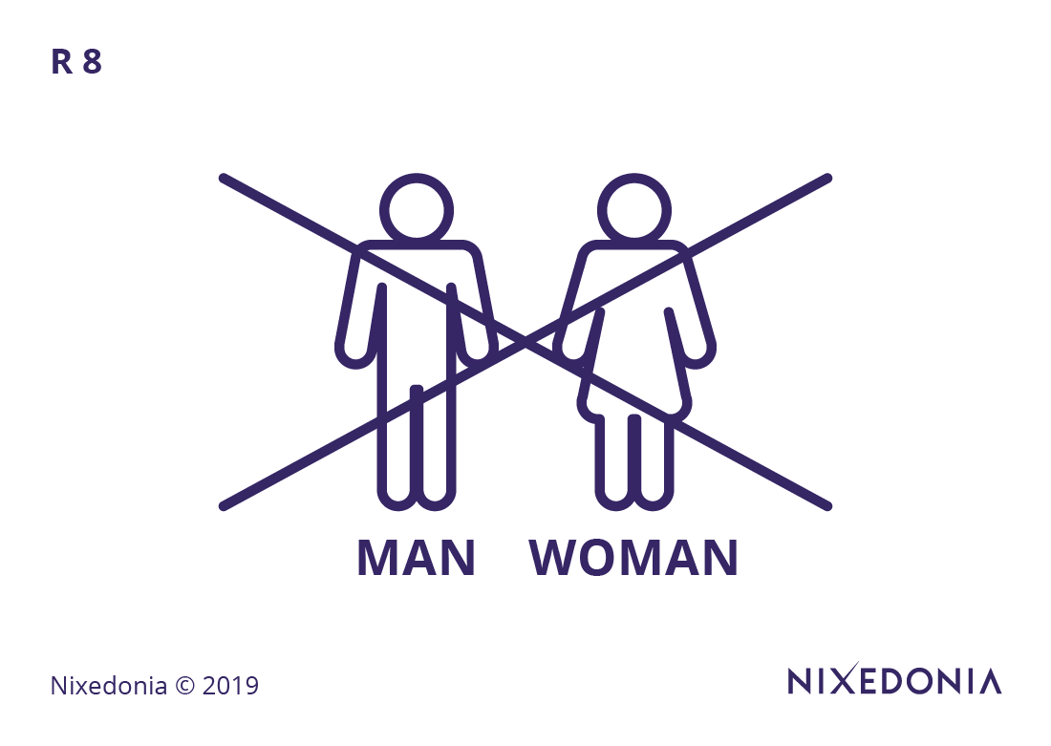
The 36 Rules of Legal Writing – Rule 08/36
8. The He/She Rule & The Ambiguous He Rule
Nixedonia © 2023

Slide 32
The 36 Rules of Legal Writing – Rule 08/36
Gender-neutral language is essential in modern legal writing to avoid bias and ambiguity. Rather than using clunky constructions such as “he/she” or “his or her,” consider rephrasing sentences to eliminate the need for gendered pronouns. Additionally, avoiding pronouns altogether where clarity requires specificity (e.g., repeating “the plaintiff” instead of using “he”) prevents confusion about referents.
8. The He/She Rule & The Ambiguous He Rule

Slide 33
The 36 Rules of Legal Writing – Rule 08/36
Mistake:
The attorney met with the client before the hearing, and he was visibly distressed.
Correction:
The attorney met with the client before the hearing, and the client was visibly distressed.
8. The He/She Rule & The Ambiguous He Rule

Slide 34
The 36 Rules of Legal Writing Exercises
The attorney conferred with the witness before he submitted the affidavit.
Contact me – John James McVeigh – for the free model answer:
james@36rules.com
Nixedonia © 2023

Slide 35

The 36 Rules of Legal Writing – Rule 09/36
9. The UOU Rule
Nixedonia © 2023

Slide 36
The 36 Rules of Legal Writing – Rule 09/36
Passive constructions should generally be avoided unless the subject is Unknown, Obvious, or Unimportant (UOU) to the reader. In cases where the actor is clear or necessary for precision, the active voice should be used (e.g., “The court dismissed the case” instead of “The case was dismissed”). However, if the actor is irrelevant (e.g., “The statute was repealed in 1995”), the passive voice may be appropriate.
9. The UOU Rule

Slide 37
The 36 Rules of Legal Writing – Rule 09/36
Mistake:
An amendment to the contract must be executed by the parties prior to any modification of the obligations arising thereunder.
Correction:
The parties must amend the contract before modifying their obligations.
9. The UOU Rule

Slide 38
The 36 Rules of Legal Writing Exercises
The closing argument was presented by the defence counsel with an emphasis on procedural impropriety.
Contact me – John James McVeigh – for the free model answer:
james@36rules.com
Nixedonia © 2023

Slide 39
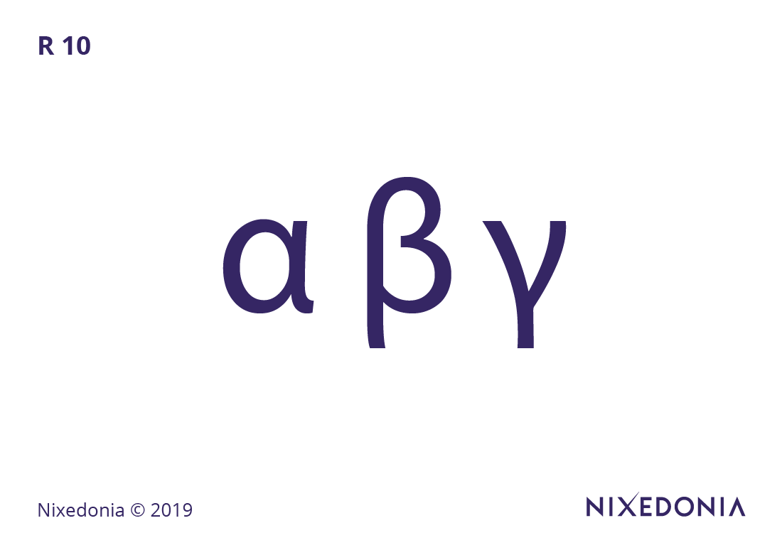
The 36 Rules of Legal Writing – Rule 10/36
10. The Topics Rule
Nixedonia © 2023

Slide 40
The 36 Rules of Legal Writing – Rule 10/36
Each paragraph in legal writing should begin with a clear topic sentence that introduces the paragraph’s main idea. Well-structured topic sentences allow readers—especially judges and opposing counsel—to quickly grasp the key arguments without needing to decipher disorganized text. A legal document should be structured so that reading only the topic sentences provides a coherent overview of the argument.
10. The Topics Rule

Slide 41
The 36 Rules of Legal Writing – Rule 10/36
Mistake:
The defendant, having reviewed the terms of the settlement offer and consulted with legal counsel, was ultimately persuaded to accept the proposal, despite initial reluctance due to concerns about financial exposure.
Correction:
After reviewing the settlement terms and consulting counsel, the defendant accepted the proposal despite initial concerns about financial exposure.
10. The Topics Rule

Slide 42
The 36 Rules of Legal Writing Exercises
The contract included multiple ambiguous terms. The defendant disputed several clauses. The court interpreted them.
Contact me – John James McVeigh – for the free model answer:
james@36rules.com
Nixedonia © 2023

Slide 43

The 36 Rules of Legal Writing – Rule 11/36
11. The Parallelisms Rule
Nixedonia © 2023

Slide 44
The 36 Rules of Legal Writing – Rule 11/36
Parallel sentence structures improve clarity, especially in lists or multi-part clauses. Inconsistent structures, such as “The court considered the evidence, reviewed the testimonies, and was ruling on the case,” disrupt flow and comprehension. Ensuring grammatical consistency within a list (e.g., “considered the evidence, reviewed the testimonies, and ruled on the case”) enhances readability and professionalism.
11. The Parallelisms Rule

Slide 45
The 36 Rules of Legal Writing – Rule 11/36
Mistake:
The arbitration clause requires that the parties submit disputes in writing, attend a preliminary mediation session, and that binding arbitration follows.
Correction:
The arbitration clause requires that the parties submit disputes in writing, attend mediation, and undergo binding arbitration.
11. The Parallelisms Rule

Slide 46
The 36 Rules of Legal Writing Exercises
The plaintiff was asked to present evidence, to articulate his argument clearly, and his demeanor should be composed.
Contact me – John James McVeigh – for the free model answer:
james@36rules.com
Nixedonia © 2023

Slide 47

The 36 Rules of Legal Writing – Rule 12/36
12. The Semicolons Rules
Nixedonia © 2023

Slide 48
The 36 Rules of Legal Writing – Rule 12/36
The semi-colon serves two primary functions in legal writing: separating closely related independent clauses and organizing complex lists. Unlike a comma, which signals a slight pause, or a period, which ends a thought, the semi-colon allows for continuity while preserving distinction. Proper use of this punctuation improves flow and prevents ambiguity, particularly in lengthy legal provisions.
12. The Semicolons Rules

Slide 49
The 36 Rules of Legal Writing – Rule 12/36
Mistake:
The plaintiff filed the motion, however, the court has not ruled on it.
Correction:
The plaintiff filed the motion; however, the court has not ruled on it.
12. The Semicolons Rules

Slide 50
The 36 Rules of Legal Writing Exercises
The defendant appealed the ruling; however the court upheld the original decision without modification.
Contact me – John James McVeigh – for the free model answer:
james@36rules.com
Nixedonia © 2023

Slide 51

The 36 Rules of Legal Writing – Rule 13/36
13. The Connectors & Signposts Rules
Nixedonia © 2023

Slide 52
The 36 Rules of Legal Writing – Rule 13/36
Legal arguments should be coherently connected through appropriate transitions (e.g., “therefore,” “however,” “in contrast”). Without these linguistic signposts, readers may struggle to follow the logic of an argument. Using appropriate connectors ensures that legal reasoning unfolds in a structured and persuasive manner.
13. The Connectors & Signposts Rules

Slide 53
The 36 Rules of Legal Writing – Rule 13/36
Mistake:
The jurisdictional issue is critical, it must be resolved before proceeding.
Correction:
The jurisdictional issue is critical; therefore, it must be resolved before proceeding.
13. The Connectors & Signposts Rules

Slide 54
The 36 Rules of Legal Writing Exercises
The judge considered the arguments and ruled against the motion without explaining why. The attorney then objected to the decision.
Contact me – John James McVeigh – for the free model answer:
james@36rules.com
Nixedonia © 2023

Slide 55

The 36 Rules of Legal Writing – Rule 14/36
14. The Who-Whom Rule
Nixedonia © 2023

Slide 56
The 36 Rules of Legal Writing – Rule 14/36
The distinction between “who” (subject) and “whom” (object) remains relevant in formal legal writing. A simple test is to substitute “he” (for who) or “him” (for whom) in the sentence: “The witness, whom the attorney questioned, testified” (because “the attorney questioned him”). Ensuring correct usage prevents grammatical errors and maintains credibility.
14. The Who-Whom Rule

Slide 57
The 36 Rules of Legal Writing – Rule 14/36
Mistake:
The defendant, who the court found liable, must pay damages.
Correction:
The defendant, whom the court found liable, must pay damages.
14. The Who-Whom Rule

Slide 58
The 36 Rules of Legal Writing Exercises
The attorney consulted with the paralegal whom she believed was best suited for the case.
Contact me – John James McVeigh – for the free model answer:
james@36rules.com
Nixedonia © 2023

Slide 59

The 36 Rules of Legal Writing – Rule 15/36
15. The Doublets & Triplets Rule
Nixedonia © 2023

Slide 60
The 36 Rules of Legal Writing – Rule 15/36
Legal writing often contains redundant word pairs (e.g., “null and void,” “cease and desist”) that should be simplified. While some doublets retain distinct meanings, most can be replaced with a single precise term. Overuse of legal doublets makes writing unnecessarily verbose and can obscure meaning.
15. The Doublets & Triplets Rule

Slide 61
The 36 Rules of Legal Writing – Rule 15/36
Mistake:
The parties agree to execute, deliver, and perform their obligations under the contract.
Correction:
The parties agree to perform their contractual obligations.
15. The Doublets & Triplets Rule

Slide 62
The 36 Rules of Legal Writing Exercises
The contract required the company to act diligently, efficiently, and in a manner that was responsible.
Contact me – John James McVeigh – for the free model answer:
james@36rules.com
Nixedonia © 2023

Slide 63

The 36 Rules of Legal Writing – Rule 16/36
16. The Structures Rules
Nixedonia © 2023

Slide 64
The 36 Rules of Legal Writing – Rule 16/36
Effective legal writing requires a well-organized structure that aligns with the logical progression of arguments. Different structural approaches can be used depending on the nature of the document: chronological structure for factual timelines, problem-solution structure for advisory memos, or cause-and-effect structure for analysing legal consequences. By consciously selecting an appropriate structure, a lawyer ensures that the reader—whether a judge, opposing counsel, or client—can follow the argument effortlessly and derive the intended conclusion with minimal effort.
16. The Structures Rules

Slide 65
The 36 Rules of Legal Writing – Rule 16/36
Mistake:
The court will review the facts, analyze the applicable law, and render a decision in due course, but first, it will require additional briefing from both parties.
Correction:
The court will review the facts, analyze the law, and issue a decision after receiving additional briefing.
16. The Structures Rules

Slide 66
The 36 Rules of Legal Writing Exercises
The argument presented by the attorney, due to its lack of logical sequencing and the unnecessary interjection of tangential points, failed to convince the court.
Contact me – John James McVeigh – for the free model answer:
james@36rules.com
Nixedonia © 2023

Slide 67

The 36 Rules of Legal Writing – Rule 17/36
17. The Articles Rules
Nixedonia © 2023

Slide 68
The 36 Rules of Legal Writing – Rule 17/36
The misuse of articles (“a,” “an,” and “the”) can create unnecessary ambiguity, particularly in contracts and statutes where precision is paramount. Indefinite articles (“a” or “an”) should be used when referring to a nonspecific entity, whereas definite articles (“the”) must be used when the noun refers to a specific, identifiable subject. Misplacing an article can change meaning entirely—for instance, “a contract” refers to any contract, while “the contract” refers to a specific, pre-identified agreement, which can lead to misinterpretation and legal disputes.
17. The Articles Rules

Slide 69
The 36 Rules of Legal Writing – Rule 17/36
Mistake:
The witness provided an testimony that was crucial to the prosecution’s case.
Correction:
The witness provided testimony that was crucial to the prosecution’s case.
17. The Articles Rules

Slide 70
The 36 Rules of Legal Writing Exercises
Counsel argued that omission of an evidentiary document in the record was a mere clerical mistake, but the appellate panel found the oversight so substantive that it rendered the judgment an nullity.
Contact me – John James McVeigh – for the free model answer:
james@36rules.com
Nixedonia © 2023

Slide 71

The 36 Rules of Legal Writing – Rule 18/36
18. The Apostrophe Rules
Nixedonia © 2023

Slide 72
The 36 Rules of Legal Writing – Rule 18/36
Apostrophes are commonly misused in legal writing, particularly in expressions of time and possession. When indicating possession, the apostrophe must be placed correctly (e.g., “the client’s argument” for singular possession vs. “the clients’ argument” for plural possession). Time-based expressions, such as “one week’s notice” or “two years’ experience,” require apostrophes to reflect possession, though many legal writers erroneously omit them. Overuse of apostrophes, especially in plural forms (“attorney’s” instead of “attorneys”), diminishes professionalism and undermines credibility.
18. The Apostrophe Rules

Slide 73
The 36 Rules of Legal Writing – Rule 18/36
Mistake:
The contracts terms were not clearly defined.
Correction:
The contract’s terms were not clearly defined.
18. The Apostrophe Rules

Slide 74
The 36 Rules of Legal Writing Exercises
The courts ruling on the claimants petition was ambiguous, leaving both parties arguments open to interpretation.
Contact me – John James McVeigh – for the free model answer:
james@36rules.com
Nixedonia © 2023

Slide 75

The 36 Rules of Legal Writing – Rule 19/36
19. The SV Agreement Rule
Nixedonia © 2023

Slide 76
The 36 Rules of Legal Writing – Rule 19/36
Subject-verb agreement is a fundamental grammatical principle that ensures clarity in legal writing. A verb must match its subject in number, even when intervening phrases create distance between them (e.g., “The list of statutes is extensive” rather than “The list of statutes are extensive”). Special attention should be given to collective nouns (e.g., “The jury deliberates” but “The jury members deliberate”) and complex subjects joined by “or” or “nor,” as mismatched agreements can lead to ambiguity in statutory and contractual interpretation.
19. The SV Agreement Rule

Slide 77
The 36 Rules of Legal Writing – Rule 19/36
Mistake:
The list of statutory provisions governing this issue were extensive.
Correction:
The list of statutory provisions governing this issue was extensive.
19. The SV Agreement Rule

Slide 78
The 36 Rules of Legal Writing Exercises
The panel of arbitrators, despite their differing opinions on procedural matters and the nuances of the applicable law, have issued a final ruling that is binding upon all parties involved in the dispute.
Contact me – John James McVeigh – for the free model answer:
james@36rules.com
Nixedonia © 2023

Slide 79

The 36 Rules of Legal Writing – Rule 20/36
20. The Colon Rules
Nixedonia © 2023

Slide 80
The 36 Rules of Legal Writing – Rule 20/36
A colon serves as a powerful tool in legal writing, often used to introduce a list, explanation, or elaboration. It should only follow a complete independent clause, ensuring the material before the colon stands alone as a full sentence. For example, “The defendant’s obligations are as follows: pay damages, return the property, and issue a public apology.” Incorrect use—such as “The defendant’s obligations include: paying damages, returning the property, and issuing an apology”—disrupts sentence structure and weakens the writing’s authority.
20. The Colon Rules

Slide 81
The 36 Rules of Legal Writing – Rule 20/36
Mistake:
The expert witness provided three main conclusions, first, the data was inaccurate.
Correction:
The expert witness provided three main conclusions: first, the data was inaccurate.
20. The Colon Rules

Slide 82
The 36 Rules of Legal Writing Exercises
The court emphasized the critical elements of a valid contract; offer, acceptance, consideration, and mutual intent to be bound, which must be established beyond mere negotiation to form a legally enforceable agreement.
Contact me – John James McVeigh – for the free model answer:
james@36rules.com
Nixedonia © 2023

Slide 83

The 36 Rules of Legal Writing – Rule 21/36
21. The Which-That Rule
Nixedonia © 2023

Slide 84
The 36 Rules of Legal Writing – Rule 21/36
Restrictive clauses, which are essential to the meaning of a sentence, require “that,” while non-restrictive clauses, which provide additional but nonessential information, require “which.” The distinction is crucial in drafting because an incorrectly placed “which” can alter contractual obligations. Consider: “The documents that were signed yesterday are valid” (restricting validity to a specific set of documents) vs. “The documents, which were signed yesterday, are valid” (merely providing additional information). Misuse of these relative pronouns can create enforceability issues.
21. The Which-That Rule

Slide 85
The 36 Rules of Legal Writing – Rule 21/36
Mistake:
The agreement which the parties signed is binding.
Correction:
The agreement that the parties signed is binding.
21. The Which-That Rule

Slide 86
The 36 Rules of Legal Writing Exercises
The proposed amendment to the contract, which was submitted after extensive negotiations and several redline revisions, will require board approval before it can be executed by the parties.
Contact me – John James McVeigh – for the free model answer:
james@36rules.com
Nixedonia © 2023

Slide 87

The 36 Rules of Legal Writing – Rule 22/36
22. The Tidy Prepositions Rule
Nixedonia © 2023

Slide 88
The 36 Rules of Legal Writing – Rule 22/36
Prepositions often clutter legal writing when they add no substantive value. Phrases such as “in regard to” should be replaced with “regarding,” and “in connection with” can often be reduced to “about” or omitted entirely. Overuse of prepositional phrases, such as “for the purpose of” instead of “to,” contributes to legalese and decreases readability. Careful editing should focus on eliminating redundant prepositions while preserving precision in meaning.
22. The Tidy Prepositions Rule

Slide 89
The 36 Rules of Legal Writing – Rule 22/36
Mistake:
The plaintiff made an argument in regards to the defendant’s liability.
Correction:
The plaintiff argued about the defendant’s liability.
22. The Tidy Prepositions Rule

Slide 90
The 36 Rules of Legal Writing Exercises
The judge inquired as to whether the plaintiff had, in light of the newly discovered evidence, considered withdrawing the motion prior to the scheduled hearing date, so as to avoid unnecessary litigation expenses.
Contact me – John James McVeigh – for the free model answer:
james@36rules.com
Nixedonia © 2023

Slide 91

The 36 Rules of Legal Writing – Rule 23/36
23. The Quotations Rule & The Left Rule of Commas
Nixedonia © 2023

Slide 92
The 36 Rules of Legal Writing – Rule 23/36
Proper punctuation in relation to quotation marks is crucial in legal writing, particularly when quoting case law, statutes, or contractual language. In American English, periods and commas should be placed inside quotation marks (“The contract is enforceable,” the judge ruled.), whereas in British English, they are placed outside unless part of the quoted material (“The contract is enforceable”, the judge ruled.). Misplacing punctuation in legal citations can lead to interpretative errors, particularly when quoting legislative provisions verbatim.
23. The Quotations Rule & The Left Rule of Commas

Slide 93
The 36 Rules of Legal Writing – Rule 23/36
Mistake:
The judge ruled “The contract is enforceable”, and dismissed the case.
Correction:
The judge ruled, “The contract is enforceable,” and dismissed the case.
23. The Quotations Rule & The Left Rule of Commas

Slide 94
The 36 Rules of Legal Writing Exercises
In his ruling, the judge stated, “The evidence presented, though compelling, fails to meet the burden of proof”.
Contact me – John James McVeigh – for the free model answer:
james@36rules.com
Nixedonia © 2023

Slide 95

The 36 Rules of Legal Writing – Rule 24/36
24. The Salutations Rule
Nixedonia © 2023

Slide 96
The 36 Rules of Legal Writing – Rule 24/36
Professional correspondence in legal settings should use appropriate and modern salutations, avoiding outdated forms like “Dear Sir/Madam.” When addressing specific individuals, use their professional titles (e.g., “Dear Judge Smith” or “Dear Counsel”). For more general legal communications, “Dear Counsel” or “To Whom It May Concern” is preferable to antiquated gendered or overly formal greetings, which can appear disconnected from contemporary legal practice.
24. The Salutations Rule

Slide 97
The 36 Rules of Legal Writing – Rule 24/36
Mistake:
Dear Sir or Madam:
Correction:
Dear Counsel:
24. The Salutations Rule

Slide 98
The 36 Rules of Legal Writing Exercises
Dear Sir/Madam, I write to you regarding the enclosed contract, which contains revisions that, in our view, must be executed at the earliest opportunity to ensure compliance with the newly enacted regulatory framework.
Contact me – John James McVeigh – for the free model answer:
james@36rules.com
Nixedonia © 2023

Slide 99
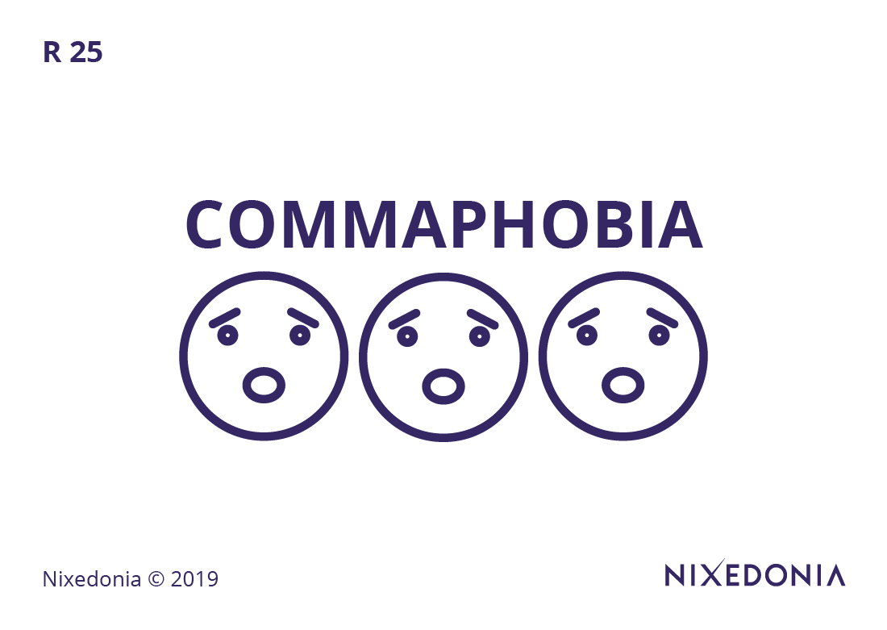
The 36 Rules of Legal Writing – Rule 25/36
25. The Commas Rules & The Commaphobia Rule
Nixedonia © 2023

Slide 100
The 36 Rules of Legal Writing – Rule 25/36
Commas play a crucial role in preventing ambiguity, particularly in legal drafting. Misuse, such as the infamous “Oxford comma” debate, can have significant legal consequences (e.g., “The contract applies to clients, partners and associates” vs. “The contract applies to clients, partners, and associates”). Equally problematic is comma splicing, where two independent clauses are joined by a comma instead of a period or semi-colon. Avoiding both overuse and underuse of commas is essential to clear and precise legal writing.
25. The Commas Rules & The Commaphobia Rule

Slide 101
The 36 Rules of Legal Writing – Rule 25/36
Mistake:
The court ruled that the agreement was invalid and therefore unenforceable.
Correction:
The court ruled that the agreement was invalid, and therefore, unenforceable.
25. The Commas Rules & The Commaphobia Rule

Slide 102
The 36 Rules of Legal Writing Exercises
The defendant who had been previously warned about the consequences of noncompliance failed to file the necessary documentation within the prescribed deadline and as a result the court dismissed the appeal without further consideration.
Contact me – John James McVeigh – for the free model answer:
james@36rules.com
Nixedonia © 2023

Slide 103

The 36 Rules of Legal Writing – Rule 26/36
26. The Modifiers Rule
Nixedonia © 2023

Slide 104
The 36 Rules of Legal Writing – Rule 26/36
Modifiers must be placed next to the words they modify to prevent ambiguity. A misplaced modifier can distort meaning, as in “Only the defendant submitted evidence,” which differs from “The defendant submitted only evidence.” Worse, a dangling modifier leaves ambiguity about what is being modified, such as “Having reviewed the contract, numerous errors were found” (unclear who reviewed the contract). Proper placement of modifiers ensures clarity and accuracy in legal arguments.
26. The Modifiers Rule

Slide 105
The 36 Rules of Legal Writing – Rule 26/36
Mistake:
Walking into the courtroom, the judge’s expression was stern.
Correction:
Walking into the courtroom, I noticed the judge’s stern expression.
26. The Modifiers Rule

Slide 106
The 36 Rules of Legal Writing Exercises
Having been drafted in haste, the judge found the contract to be ambiguous and internally inconsistent, requiring significant clarification before enforcement.
Contact me – John James McVeigh – for the free model answer:
james@36rules.com
Nixedonia © 2023

Slide 107

The 36 Rules of Legal Writing – Rule 27/36
27. The Homophones Rules
Nixedonia © 2023

Slide 108
The 36 Rules of Legal Writing – Rule 27/36
Homophones—words that sound alike but have different meanings—are particularly problematic in legal writing, where precision is essential. Common errors include principle/principal, advice/advise, and affect/effect, each of which carries distinct legal implications. A misused homophone in a contract, statute, or pleading can create enforceability issues, undermine credibility, and, in some cases, lead to litigation over interpretation.
27. The Homophones Rules

Slide 109
The 36 Rules of Legal Writing – Rule 27/36
Mistake:
The principle argument made by the attorney was flawed.
Correction:
The principal argument made by the attorney was flawed.
27. The Homophones Rules

Slide 110
The 36 Rules of Legal Writing Exercises
The council for the respondent argued that the principle of estoppel should prevent the claimant from asserting rights under the disputed agreement, given the previous contradictory statements made in correspondence with the opposing party.
Contact me – John James McVeigh – for the free model answer:
james@36rules.com
Nixedonia © 2023

Slide 111

The 36 Rules of Legal Writing – Rule 28/36
28. The IONS Rule
Nixedonia © 2023

Slide 112
The 36 Rules of Legal Writing – Rule 28/36
Nominalizations—turning verbs into abstract nouns—should be avoided where possible because they create wordy and less dynamic writing. Instead of “The attorney made an argument in support of the motion,” write “The attorney argued in support of the motion.” Overuse of such constructions (“gave consideration to” instead of “considered”) makes legal writing unnecessarily cumbersome and should be minimized.
28. The IONS Rule

Slide 113
The 36 Rules of Legal Writing – Rule 28/36
Mistake:
The parties reached an agreement for the resolution of the dispute.
Correction:
The parties agreed to resolve the dispute.
28. The IONS Rule

Slide 114
The 36 Rules of Legal Writing Exercises
The corporation has made an application for an extension of time in order to facilitate the completion of the due diligence process that remains necessary prior to the execution of the final transactional documents.
Contact me – John James McVeigh – for the free model answer:
james@36rules.com
Nixedonia © 2023

Slide 115

The 36 Rules of Legal Writing – Rule 29/36
29. The Rules of Titles & Degrees
Nixedonia © 2023

Slide 116
The 36 Rules of Legal Writing – Rule 29/36
Overuse of professional titles and degrees in legal documents is unnecessary and can clutter writing. “John Smith, JD, LLM, Esq.” is excessive, as the degrees are implied by professional context. In most cases, use a single, most relevant designation (e.g., “John Smith, JD” or “Attorney John Smith”) rather than listing multiple qualifications that do not enhance clarity.
29. The Rules of Titles & Degrees

Slide 117
The 36 Rules of Legal Writing – Rule 29/36
Mistake:
The agreement was signed by John Smith, Esq., LLM, PhD, and Jane Doe, JD, MBA.
Correction:
The agreement was signed by John Smith, PhD, and Jane Doe, JD.
29. The Rules of Titles & Degrees

Slide 118
The 36 Rules of Legal Writing Exercises
We are pleased to announce that John Smith, Esq., J.D., LL.M., Ph.D., will be delivering a keynote address at the annual corporate governance symposium, where he will discuss the evolving regulatory landscape for multinational corporations.
Contact me – John James McVeigh – for the free model answer:
james@36rules.com
Nixedonia © 2023

Slide 119

The 36 Rules of Legal Writing – Rule 30/36
30. The Dangling Modifiers Rule
Nixedonia © 2023

Slide 120
The 36 Rules of Legal Writing – Rule 30/36
A dangling modifier occurs when a descriptive phrase does not logically attach to a subject, leading to ambiguity. “After reviewing the evidence, the conclusion was clear” incorrectly suggests that the conclusion, rather than the writer or judge, reviewed the evidence. Ensuring that every modifier explicitly relates to a noun or pronoun prevents misinterpretation.
30. The Dangling Modifiers Rule

Slide 121
The 36 Rules of Legal Writing – Rule 30/36
Mistake:
Having reviewed the evidence, the defendant’s argument was unconvincing.
Correction:
Having reviewed the evidence, the court found the defendant’s argument unconvincing.
30. The Dangling Modifiers Rule

Slide 122
The 36 Rules of Legal Writing Exercises
While negotiating the terms of the contract, several ambiguities were discovered that necessitated further clarification before execution.
Contact me – John James McVeigh – for the free model answer:
james@36rules.com
Nixedonia © 2023

Slide 123

The 36 Rules of Legal Writing – Rule 31/36
31. The Rule of Sentence Fragments
Nixedonia © 2023

Slide 124
The 36 Rules of Legal Writing – Rule 31/36
A sentence fragment occurs when a sentence is incomplete—lacking a subject, a verb, or a complete thought. In legal writing, fragments often appear when writers separate ideas into multiple sentences for emphasis but fail to ensure grammatical completeness. For example, “The attorney argued for dismissal. Because the statute of limitations had expired.” The second sentence is a fragment, as it depends on the first for clarity. The corrected version—“The attorney argued for dismissal because the statute of limitations had expired.”—ensures grammatical correctness while maintaining readability. Fragments can make legal arguments appear disjointed, leading to confusion, particularly in contracts and pleadings where precision is essential.
31. The Rule of Sentence Fragments

Slide 125
The 36 Rules of Legal Writing – Rule 31/36
Mistake:
The attorney drafted the contract. And then waited for client approval.
Correction:
The attorney drafted the contract and then waited for client approval.
31. The Rule of Sentence Fragments

Slide 126
The 36 Rules of Legal Writing Exercises
Because the arbitrator failed to address the central issue in the dispute. The parties were left without clear guidance on enforcement of the contractual provisions.
Contact me – John James McVeigh – for the free model answer:
james@36rules.com
Nixedonia © 2023

Slide 127

The 36 Rules of Legal Writing – Rule 32/36
32. The Pronouns Rules
Nixedonia © 2023

Slide 128
The 36 Rules of Legal Writing – Rule 32/36
Pronouns must agree in number and clarity with their antecedents, or they risk introducing ambiguity into legal writing. A common mistake occurs when a pronoun lacks a clear referent: “The judge informed the lawyer that he must submit additional documents.” Here, “he” is ambiguous—does it refer to the judge or the lawyer? A clearer sentence would be: “The judge informed the lawyer that the lawyer must submit additional documents.” Additionally, plural pronouns should not be used to refer to singular antecedents, as in “Each partner must submit their report” (incorrect). The correct form is either “Each partner must submit his or her report” or a restructured version: “Partners must submit their reports.” Ensuring pronoun clarity prevents misinterpretation in contracts, court rulings, and legal correspondence.
32. The Pronouns Rules

Slide 129
The 36 Rules of Legal Writing – Rule 32/36
Mistake:
Each partner must submit their tax documents by the deadline.
Correction:
Each partner must submit his or her tax documents by the deadline.
32. The Pronouns Rules

Slide 130
The 36 Rules of Legal Writing Exercises
Each partner in the firm must ensure that they are in compliance with continuing legal education requirements mandated by the jurisdiction in which they practice.
Contact me – John James McVeigh – for the free model answer:
james@36rules.com
Nixedonia © 2023

Slide 131

The 36 Rules of Legal Writing – Rule 33/36
33. The Modals Rules
Nixedonia © 2023
Nixedonia © 2023

Slide 132
The 36 Rules of Legal Writing – Rule 33/36
Modal verbs (e.g., must, shall, should, may, can, will) express different degrees of obligation, permission, or possibility, and misusing them can lead to severe legal consequences. For instance, in a contract, “The tenant should pay rent on the first of the month” implies a recommendation, whereas “The tenant must pay rent on the first of the month” imposes a strict obligation. Similarly, “may” conveys discretion, as in “The board may terminate the agreement,” whereas “shall” (which should generally be avoided) can be ambiguous and misinterpreted. Understanding the subtle distinctions between these modal verbs ensures that legal writing conveys the precise level of obligation or discretion intended, reducing the risk of contractual disputes.
33. The Modals Rules

Slide 133
The 36 Rules of Legal Writing – Rule 33/36
Mistake:
The court ruled that the defendant should to pay damages.
Correction:
The court ruled that the defendant should pay damages.
33. The Modals Rules

Slide 134
The 36 Rules of Legal Writing Exercises
The lessee may not sublet the premises without prior written consent of the lessor, as per the express terms of the lease agreement.
Contact me – John James McVeigh – for the free model answer:
james@36rules.com
Nixedonia © 2023

Slide 135

The 36 Rules of Legal Writing – Rule 34/36
34. The Rules of Capitalization
Nixedonia © 2023
Nixedonia © 2023

Slide 136
The 36 Rules of Legal Writing – Rule 34/36
Capitalization in legal writing follows strict conventions, particularly regarding case names, legal doctrines, and statutory references. Overcapitalization (e.g., “The Defendant filed a Motion with the Court”) can make a document appear unprofessional, while undercapitalization (e.g., “the united states supreme court”) can undermine credibility. Proper usage dictates that parties in a specific case should be capitalized when referring to them directly (e.g., “Plaintiff” in The State v. Smith) but should be lowercase in general references (e.g., “the plaintiff filed a motion”). Statutes, official titles, and proper nouns should always be capitalized, ensuring that legal documents maintain consistency and adhere to professional standards.
34. The Rules of Capitalization

Slide 137
The 36 Rules of Legal Writing – Rule 34/36
Mistake:
The Plaintiff filed a motion against the defendant.
Correction:
The plaintiff filed a motion against the defendant.
34. The Rules of Capitalization

Slide 138
The 36 Rules of Legal Writing Exercises
The defendant contended that the ruling of the european court of human rights should be given deference in interpreting the applicable treaty obligations.
Contact me – John James McVeigh – for the free model answer:
james@36rules.com
Nixedonia © 2023

Slide 139

The 36 Rules of Legal Writing – Rule 35/36
35. The Rules of Conditionals
Nixedonia © 2023
Nixedonia © 2023

Slide 140
The 36 Rules of Legal Writing – Rule 35/36
Conditional statements in legal writing dictate how certain legal consequences depend on specific conditions. Incorrect use of verb forms in conditionals can lead to ambiguity and misinterpretation. For example, “If the parties would have signed the contract, they could have avoided litigation” is incorrect; the proper phrasing is “If the parties had signed the contract, they could have avoided litigation.” Conditionals must follow established structures: first conditional for real possibilities (“If the tenant pays rent late, the landlord will charge a penalty”); second conditional for hypothetical situations (“If the tenant were to miss a payment, the lease would terminate”); and third conditional for past hypotheticals (“If the tenant had paid on time, the lease would not have been terminated”). Proper use of conditionals ensures that legal writing conveys obligations and hypothetical scenarios with absolute clarity.
35. The Rules of Conditionals

Slide 141
The 36 Rules of Legal Writing – Rule 35/36
Mistake:
If the parties would have agreed earlier, the litigation could have been avoided.
Correction:
If the parties had agreed earlier, the litigation could have been avoided.
35. The Rules of Conditionals

Slide 142
The 36 Rules of Legal Writing Exercises
If the plaintiff would have provided sufficient evidence of causation, the court might have ruled in his favour and awarded damages accordingly.
Contact me – John James McVeigh – for the free model answer:
james@36rules.com
Nixedonia © 2023

Slide 143

The 36 Rules of Legal Writing – Rule 36/36
36. The Its Rule
Nixedonia © 2023
Nixedonia © 2023

Slide 144
The 36 Rules of Legal Writing – Rule 36/36
The confusion between “its” (possessive) and “it’s” (contraction for “it is” or “it has”) is one of the most common yet avoidable errors in legal writing. In legal contracts, where precision is critical, a misused apostrophe can lead to unintended interpretations. For example, “The corporation increased it’s revenue this quarter” is incorrect because “it’s” means “it is.” The correct sentence is “The corporation increased its revenue this quarter.” While this may seem like a minor grammatical issue, misplacing an apostrophe in a legal document can undermine the writer’s credibility and, in some cases, cause significant confusion in contractual provisions.
36. The Its Rule

Slide 145
The 36 Rules of Legal Writing – Rule 36/36
Mistake:
The corporation expanded it’s operations internationally.
Correction:
The corporation expanded its operations internationally.
36. The Its Rule

Slide 146
The 36 Rules of Legal Writing Exercises
The law firm recently expanded it’s litigation practice to include international arbitration, following increased demand from global clients seeking dispute resolution services.
Contact me – John James McVeigh – for the free model answer:
james@36rules.com
Nixedonia © 2023

Slide 147
The 36 Rules of Legal Writing
Follow me on my Socials:
John James’ Contacts
http://www.facebook.com/john.mcveigh
http://www.instagram.com/johnjamesmcveigh
http://www.linkedin.com/in/john-james-mcveigh
james@36rules.com
WhatsApp: +44-7534-729-009

