Slide 1




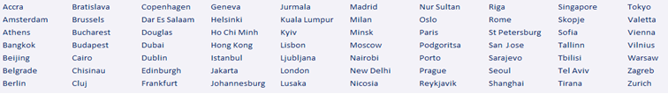
The 36 Rules of Legal Writing QUIZ
The most important rules for lawyers to know to avoid their most common mistakes in legal writing
John James McVeigh DTEFL, MBA, LLM
 | John James McVeigh DTEFL, MBA, LLM Chief Executive Officer, Nixedonia +44-7534-729-009 (Mobile & WhatsApp) james@36rules.com http://www.36rules.com/

Slide 2





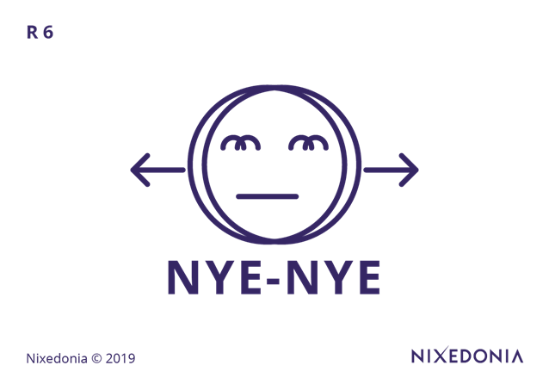

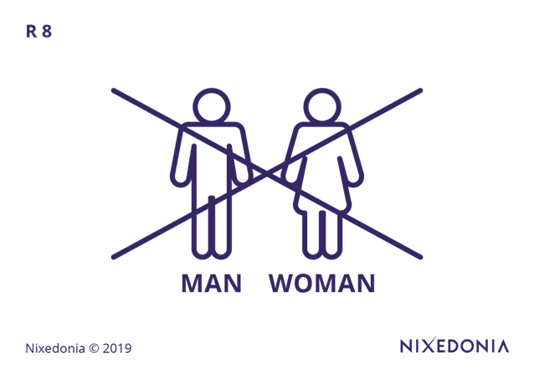

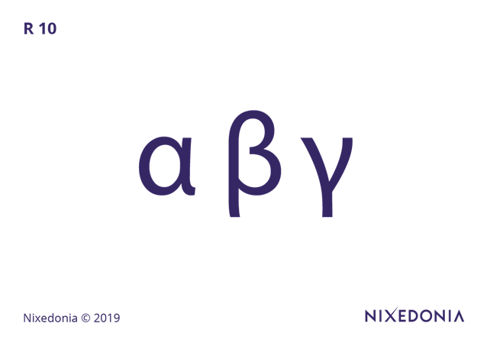










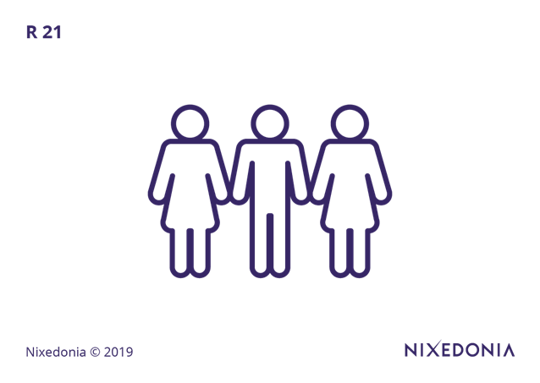



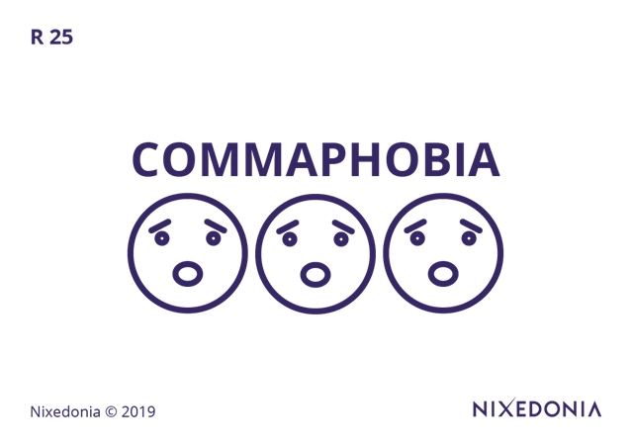











The 36 Rules
of Legal Writing & Their Pictograms

Slide 3
The 36 Rules of Legal Writing – Rule 01/36
Which of the following best represents the principle of The Plain English Rule in legal writing?
A) Using formal and traditional legal terms such as heretofore and aforementioned to maintain professionalism.
B) Ensuring that legal documents use complex structures to reflect the seriousness of the law.
C) Prioritizing clarity and accessibility by eliminating unnecessary legal jargon and archaic language.
D) Maximizing the use of Latin phrases to reinforce the authoritative nature of the legal argument.
1. The Plain English Rule
Nixedonia © 2023

Slide 4
The 36 Rules of Legal Writing – Rule 02/36
According to The 1-Ruble Rule, which sentence best follows the principle of concise legal writing?
A) “It is the considered opinion of the undersigned legal counsel that, in light of the evidentiary materials submitted herewith, the defendant has failed to meet the requisite burden of proof necessary to establish a prima facie case.”
B) “In accordance with the principles of judicial economy and procedural efficiency, the court finds it necessary to dismiss the claim at this juncture.”
C) “The defendant has not met the burden of proof to establish a prima facie case.”
D) “Owing to the fact that the appellate brief contained superfluous verbiage, the reviewing panel expended an inordinate amount of time parsing its substantive content.”
2. The 1-Ruble Rule

Slide 5
The 36 Rules of Legal Writing – Rule 03/36
Which of the following sentences correctly follows The Subject-Verb-Object (SVO) Rule?
A) “A decision on the motion for summary judgment, after careful consideration of the affidavits submitted and in light of the controlling precedent, was issued by the court.”
B) “The motion for summary judgment, having been reviewed thoroughly, was decided by the judge.”
C) “The court issued a decision on the motion for summary judgment after considering the affidavits and precedent.”
D) “After careful evaluation of the submitted affidavits and controlling precedent, a decision on the motion for summary judgment was handed down.”
3. The SVO Rule

Slide 6
The 36 Rules of Legal Writing – Rule 04/36
Why is the word shall discouraged in modern legal writing?
A) Because it is considered informal and lacks the necessary authority in contracts.
B) Because it can have multiple meanings—obligation, futurity, or mere possibility—leading to ambiguity.
C) Because legal professionals prefer using more archaic and sophisticated terminology.
D) Because it is not recognized in many jurisdictions and is therefore unenforceable.
4. The Shan’t Rule

Slide 7
The 36 Rules of Legal Writing – Rule 05/36
The Babushka Rule suggests that legal writing should be understandable to:
A) A specialist in the field who is familiar with all legal terminology.
B) Any intelligent, non-legal reader, including an elderly layperson with no legal training.
C) Only lawyers and judges, as they are the primary audience for legal documents.
D) Professionals in related fields, such as finance and compliance, who may need to interpret contracts.
5. The Babushka Rule

Slide 8
The 36 Rules of Legal Writing – Rule 06/36
Which of the following sentences violates The Nye-Nye Rule by using unnecessary double negatives?
A) “The claimant has provided sufficient evidence to refute the respondent’s allegations.”
B) “It is not the case that the claimant has failed to provide sufficient evidence to refute the allegations set forth by the respondent.”
C) “The plaintiff may file a claim against the defendant under these circumstances.”
D) “The contract prohibits the lessee from subletting the premises without prior written consent.”
6. The Nye-Nye Rule

Slide 9
The 36 Rules of Legal Writing – Rule 07/36
Which sentence best follows the Keep It Simple, Silly
(KISS) Rule?
A) “All parties who have executed the agreement and who have obtained the necessary governmental approvals shall be considered eligible for participation in the contractual arrangement.”
B) “Any party that signs the agreement and obtains the required approvals may participate in the contract.”
C) “Following the execution of the agreement and the acquisition of governmental approvals, eligibility for participation in the contractual arrangement shall be conferred upon the parties.”
D) “In light of the executed agreement and governmental approvals, all eligible parties shall be permitted to partake in the contractual arrangement.”
7. The KISS Rule

Slide 10
The 36 Rules of Legal Writing – Rule 08/36
Which sentence best avoids ambiguity in pronoun usage?
A) “The attorney met with the client before the hearing, and he was visibly distressed.”
B) “The judge spoke to the witness before the testimony, and he was nervous.”
C) “The attorney met with the client before the hearing, and the client was visibly distressed.”
D) “Before the hearing, the attorney met with the client, who was visibly distressed, which caused concern for the judge.”
8. The He/She Rule & The Ambiguous He Rule

Slide 11
The 36 Rules of Legal Writing – Rule 09/36
Which sentence correctly applies The UOU (Unknown, Obvious, or Unimportant) Rule regarding passive voice?
A) “An amendment to the contract must be executed by the parties prior to any modification of the obligations arising thereunder.”
B) “The court dismissed the case due to lack of evidence.”
C) “The motion was filed by the defence counsel after reviewing the statutory requirements.”
D) “A ruling was issued by the judge after considering all arguments presented.”
9. The UOU Rule

Slide 12
The 36 Rules of Legal Writing – Rule 10/36
Which of the following sentences best follows The Topics Rule for paragraph structure?
A) “The defendant, having reviewed the terms of the settlement offer and consulted with legal counsel, was ultimately persuaded to accept the proposal, despite initial reluctance due to concerns about financial exposure.”
B) “After reviewing the settlement terms and consulting counsel, the defendant accepted the proposal despite initial concerns about financial exposure.”
C) “While reviewing the settlement, consulting legal counsel, and considering financial exposure, the defendant ultimately decided to accept the offer.”
D) “The settlement terms were reviewed, legal counsel was consulted, and financial exposure was considered before the defendant’s acceptance of the proposal.”
10. The Topics Rule

Slide 13
The 36 Rules of Legal Writing – Rule 11/36
Which of the following sentences demonstrates correct parallel structure?
A) “The arbitration clause requires that the parties submit disputes in writing, attend a preliminary mediation session, and that binding arbitration follows.”
B) “The arbitration clause requires that the parties submit disputes in writing, attend mediation, and undergo binding arbitration.”
C) “The arbitration clause requires the submission of disputes in writing, attendance at mediation, and the process of binding arbitration.”
D) “The arbitration clause requires that disputes are submitted in writing, that attendance at mediation is mandatory, and that the parties shall undergo binding arbitration.”
11. The Parallelisms Rule

Slide 14
The 36 Rules of Legal Writing – Rule 12/36
Which of the following sentences correctly uses a semicolon?
A) “The plaintiff filed the motion, however, the court has not ruled on it.”
B) “The plaintiff filed the motion; however, the court has not ruled on it.”
C) “The plaintiff filed the motion however; the court has not ruled on it.”
D) “The plaintiff filed the motion; and, the court has not ruled on it.”
12. The Semicolons Rules

Slide 15
The 36 Rules of Legal Writing – Rule 13/36
Which of the following sentences best demonstrates the proper use of connectors and signposts?
A) “The jurisdictional issue is critical, it must be resolved before proceeding.”
B) “The jurisdictional issue is critical; therefore, it must be resolved before proceeding.”
C) “The issue of jurisdiction is a fundamental consideration. The case cannot proceed otherwise.”
D) “The jurisdictional issue is critical, thus, resolving it before proceeding is imperative.”
13. The Connectors & Signposts Rules

Slide 16
The 36 Rules of Legal Writing – Rule 14/36
Which sentence correctly follows the rule for using "who" vs. "whom"?
A) “The defendant, who the court found liable, must pay damages.”
B) “The witness, whom provided key testimony, was recalled for questioning.”
C) “The plaintiff, whom the judge ruled in favour of, was awarded damages.”
D) “The defendant, whom the court found liable, must pay damages.”
14. The Who-Whom Rule

Slide 17
The 36 Rules of Legal Writing – Rule 15/36
Which of the following sentences best follows the rule against redundant doublets and triplets?
A) “The parties agree to execute, deliver, and perform their obligations under the contract.”
B) “The parties agree to fulfil their contractual obligations.”
C) “The parties agree to sign, execute, and fulfil their duties.”
D) “The parties agree to draft, formalize, and finalize their contract.”
15. The Doublets & Triplets Rule

Slide 18
The 36 Rules of Legal Writing – Rule 16/36
Which of the following sentences best demonstrates a logical and structured approach to legal writing?
A) “The court will review the facts, analyse the law, and issue a decision after receiving additional briefing.”
B) “The court will, after reviewing the facts, analyse the law, but will require additional briefing before issuing a decision.”
C) “Reviewing the facts, analysing the law, and issuing a decision will be undertaken by the court following receipt of additional briefing.”
D) “A decision will be issued after the court reviews the facts, additional briefing is required before the analysis of the law.”
16. The Structures Rules

Slide 19
The 36 Rules of Legal Writing – Rule 17/36
Which sentence correctly applies the rule regarding articles ("a," "an," "the")?
A) “The witness provided an testimony that was crucial to the prosecution’s case.”
B) “The witness provided a testimony that was crucial to the prosecution’s case.”
C) “The witness provided testimony that was crucial to the prosecution’s case.”
D) “The witness provided the testimony which was crucial to the prosecution’s case.”
17. The Articles Rules

Slide 20
The 36 Rules of Legal Writing – Rule 18/36
Which sentence correctly follows the rules for apostrophe usage?
A) “The contracts terms were not clearly defined.”
B) “The contract’s terms were not clearly defined.”
C) “The contracts’ terms was not clearly defined.”
D) “The contracts terms’ were not clearly defined.”
18. The Apostrophe Rules

Slide 21
The 36 Rules of Legal Writing – Rule 19/36
Which of the following sentences correctly applies The Subject-Verb Agreement Rule?
A) “The list of statutory provisions governing this issue were extensive.”
B) “The list of statutory provisions governing this issue was extensive.”
C) “The statutory provisions governing this issue is extensive.”
D) “The statutory provisions, which includes multiple sections, is extensive.”
19. The SV Agreement Rule

Slide 22
The 36 Rules of Legal Writing – Rule 20/36
Which of the following sentences correctly applies The Colon Rules?
A) “The expert witness provided three main conclusions, first, the data was inaccurate.”
B) “The expert witness provided three main conclusions: first, the data was inaccurate.”
C) “The expert witness provided: three main conclusions, first, the data was inaccurate.”
D) “The expert witness provided three main conclusions; first, the data was inaccurate.”
20. The Colon Rules

Slide 23
The 36 Rules of Legal Writing – Rule 21/36
Which sentence correctly applies the distinction between "which" and "that"?
A) “The agreement which the parties signed is binding.”
B) “The agreement, that the parties signed, is binding.”
C) “The agreement that the parties signed is binding.”
D) “The agreement, that the parties signed, which is binding.”
21. The Which-That Rule

Slide 24
The 36 Rules of Legal Writing – Rule 22/36
Which sentence correctly eliminates unnecessary prepositions?
A) “The plaintiff made an argument in regards to the defendant’s liability.”
B) “The plaintiff argued about the defendant’s liability.”
C) “The plaintiff made an argument concerning the nature of the liability of the defendant.”
D) “The plaintiff, with respect to the allegations, has made an argument regarding the issue of liability.”
22. The Tidy Prepositions Rule

Slide 25
The 36 Rules of Legal Writing – Rule 23/36
Which of the following sentences correctly follows the rule for punctuation and quotation marks?
A) “The judge ruled, ‘The contract is enforceable’, and dismissed the case.”
B) “The judge ruled, ‘The contract is enforceable,’ and dismissed the case.”
C) “The judge ruled ‘The contract is enforceable,’ and dismissed the case.”
D) “The judge ruled, ‘The contract is enforceable’ and dismissed the case,”
23. The Quotations Rule & The Left Rule of Commas

Slide 26
The 36 Rules of Legal Writing – Rule 24/36
Which of the following is the best salutation for a formal legal letter?
A) “Dear Sir or Madam,”
B) “To Whom It May Concern,”
C) “Dear Esteemed Legal Professional,”
D) “Respected Counsel,”
24. The Salutations Rule

Slide 27
The 36 Rules of Legal Writing – Rule 25/36
Which sentence correctly applies The Commas Rules?
A) “The court ruled that the agreement was invalid and therefore unenforceable.”
B) “The court ruled that the agreement was invalid, and therefore, unenforceable.”
C) “The court ruled, that the agreement was invalid, and therefore unenforceable.”
D) “The court ruled that the agreement was, invalid and, therefore unenforceable.”
25. The Commas Rules & The Commaphobia Rule

Slide 28
The 36 Rules of Legal Writing – Rule 26/36
Which of the following sentences correctly places the modifier?
A) “Walking into the courtroom, the judge’s expression was stern.”
B) “Having been drafted in haste, the judge found the contract ambiguous.”
C) “The judge found the contract ambiguous, having been drafted in haste.”
D) “Having been drafted in haste, the contract was ambiguous.”
26. The Modifiers Rule

Slide 29
The 36 Rules of Legal Writing – Rule 27/36
Which sentence correctly follows The Homophones Rules?
A) “The principle argument made by the attorney was flawed.”
B) “The principal argument made by the attorney was flawed.”
C) “The council for the plaintiff presented a compelling case.”
D) “The defendant stated that the weather had no affect on the accident.”
27. The Homophones Rules

Slide 30
The 36 Rules of Legal Writing – Rule 28/36
Which sentence correctly avoids unnecessary nominalizations?
A) “The corporation has made an application for an extension of time.”
B) “The corporation has applied for a time extension.”
C) “The corporation is in the process of making an application for an extension of time.”
D) “The corporation has facilitated the application process for an extension of time.”
28. The IONS Rule

Slide 31
The 36 Rules of Legal Writing – Rule 29/36
Which of the following follows the rule for using professional titles correctly?
A) “The agreement was signed by John Smith, Esq., LLM, PhD, and Jane Doe, JD, MBA.”
B) “The agreement was signed by Attorney John Smith and Attorney Jane Doe.”
C) “The agreement was signed by John Smith, JD, Esq., and Jane Doe, JD, Esq.”
D) “The agreement was signed by John Smith, LLM, and Jane Doe, JD.”
29. The Rules of Titles & Degrees

Slide 32
The 36 Rules of Legal Writing – Rule 30/36
Which sentence correctly avoids a dangling modifier?
A) “Having reviewed the evidence, the defendant’s argument was unconvincing.”
B) “While negotiating the contract, several ambiguities were discovered.”
C) “After reviewing the contract, the judge found multiple inconsistencies.”
D) “To argue effectively, preparation must be thorough.”
30. The Dangling Modifiers Rule

Slide 33
The 36 Rules of Legal Writing – Rule 31/36
Which sentence correctly avoids a sentence fragment?
A) “Because the arbitrator failed to address the central issue in the dispute. The parties were left without clear guidance on enforcement of the contractual provisions.”
B) “The arbitrator failed to address the central issue in the dispute, leaving the parties without clear guidance on enforcement of the contractual provisions.”
C) “The arbitrator failed to address the central issue in the dispute. Which left the parties without clear guidance on enforcement of the contractual provisions.”
D) “The arbitrator’s failure to address the central issue in the dispute. The parties lacked clear guidance on enforcement of the contractual provisions.”
31. The Rule of Sentence Fragments

Slide 34
The 36 Rules of Legal Writing – Rule 32/36
Which of the following sentences avoids ambiguity in pronoun usage?
A) “The judge informed the lawyer that he must submit additional documents.”
B) “The judge informed the lawyer that the lawyer must submit additional documents.”
C) “The judge told the lawyer that he was not satisfied with the evidence.”
D) “The judge stated that he must review the case before making a ruling.”
32. The Pronouns Rules

Slide 35
The 36 Rules of Legal Writing – Rule 33/36
Which of the following sentences correctly applies the rule for modal verbs?
A) “The court ruled that the defendant should to pay damages.”
B) “The court ruled that the defendant must pay damages.”
C) “The court ruled that the defendant will to pay damages.”
D) “The court ruled that the defendant ought pay damages.”
33. The Modals Rules

Slide 36
The 36 Rules of Legal Writing – Rule 34/36
Which of the following sentences follows the correct capitalization rules?
A) “The Plaintiff filed a motion against the defendant.”
B) “The defendant contended that the ruling of the european court of human rights should be given deference.”
C) “The plaintiff filed a motion against the defendant.”
D) “The court ruled that the supreme court’s precedent should be applied.”
34. The Rules of Capitalization

Slide 37
The 36 Rules of Legal Writing – Rule 35/36
Which sentence correctly follows The Rule of Conditionals?
A) “If the parties would have agreed earlier, the litigation could have been avoided.”
B) “If the parties had agreed earlier, the litigation could have been avoided.”
C) “If the parties agreed earlier, the litigation would have avoided.”
D) “If the parties should have agreed earlier, the litigation may have been avoided.”
35. The Rules of Conditionals

Slide 38
The 36 Rules of Legal Writing – Rule 36/36
Which sentence correctly applies the rule for “its” vs. “it’s”?
A) “The corporation expanded it’s operations internationally.”
B) “The corporation expanded its operations internationally.”
C) “The law firm recently expanded it’s litigation practice.”
D) “The company increased it’s revenue this quarter.”
36. The Its Rule

Slide 39
The 36 Rules of Legal Writing
1C | 7B | 13B | 19B | 25B | 31B
2C | 8C | 14D | 20B | 26D | 32B
3C | 9B | 15B | 21C | 27B | 33B
4B | 10B | 16A | 22B | 28B | 34C
5B | 11B | 17C | 23B | 29D | 35B
6B | 12B | 18B | 24B | 30C | 36B
ANSWERS
Email me if you have any questions regarding these answers – james@36rules.com

Slide 40
The 36 Rules of Legal Writing
Follow me on my Socials:
John James’ Contacts
http://www.facebook.com/john.mcveigh
http://www.instagram.com/johnjamesmcveigh
http://www.linkedin.com/in/john-james-mcveigh
james@36rules.com
WhatsApp: +44-7534-729-009

